Slide 1
EAB-Navigate
Notes:
Purpose: To show how useful Navigate can be for faculty and staff. Use of Navigate increases communication between offices because the advice given to students is documented in their educational record.

Slide 2
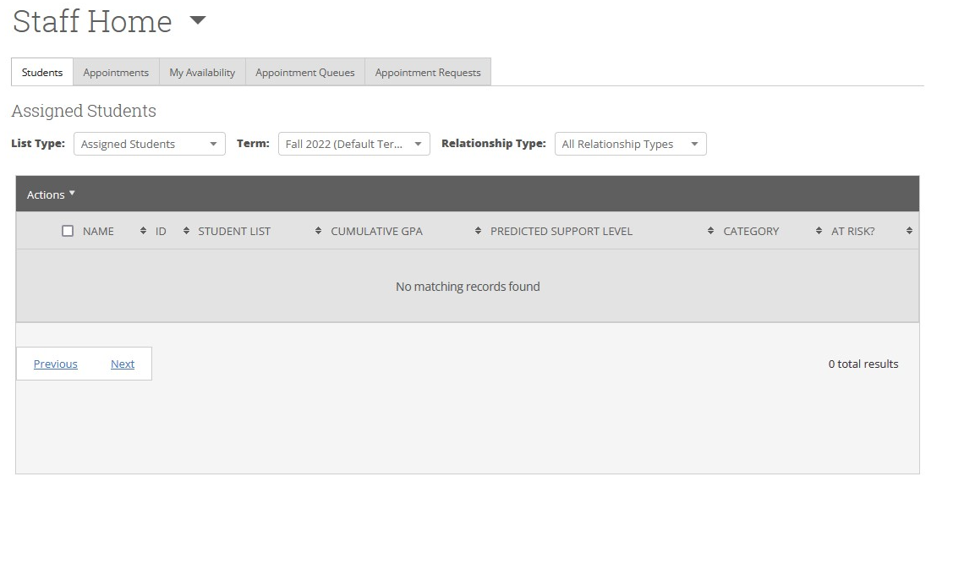
Setting up your calendar availability
Appointment availability is the most important step for staff who want to leverage Navigate's appointment scheduling and management capabilities. Availability impacts when and how your students experience the scheduling workflow. It determines when students can schedule appointments or drop in with you. Your ability to take part in Appointment Campaigns — either ones created by you or your departmental manager — is also linked to Availability. We recommend creating availability first, even before syncing your calendar.

Slide 3
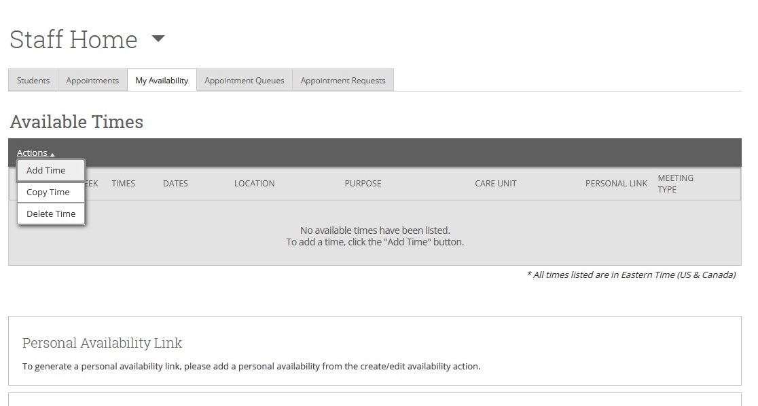

Slide 4
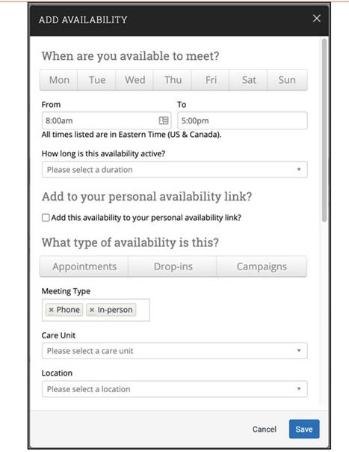
Availability lets staff indicate the days, times, locations, and services they offer when they meet with students.
There is significant flexibility when you create availabilities. Staff can choose the length of the availability’s duration, which can range from a specific set of dates to forever. Availability can be set for appointments, drop-in visits, and/or appointment campaigns. Staff can create course-specific availability such as course-based tutoring. For group appointments, staff can set the maximum number of students for a single appointment slot.

Slide 5
Sync EAB/Navigate calendar with your Google Calendar
Click on your calendar
Then select the Settings and Sync button

Slide 6
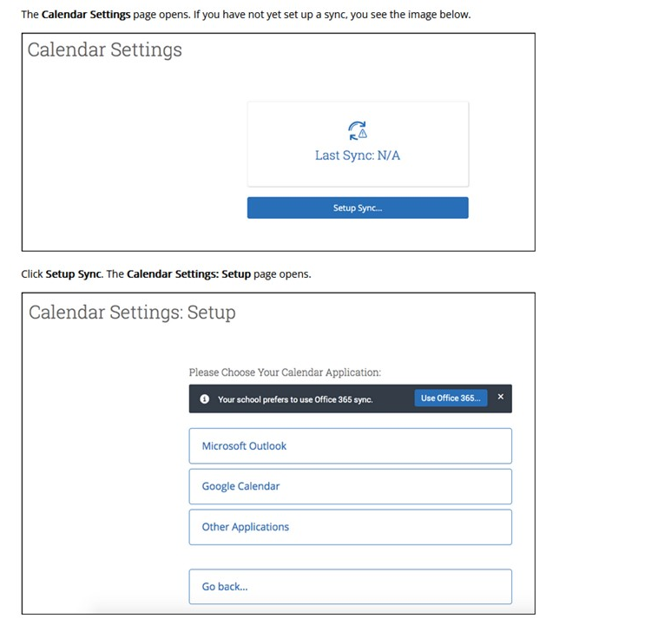

Slide 7
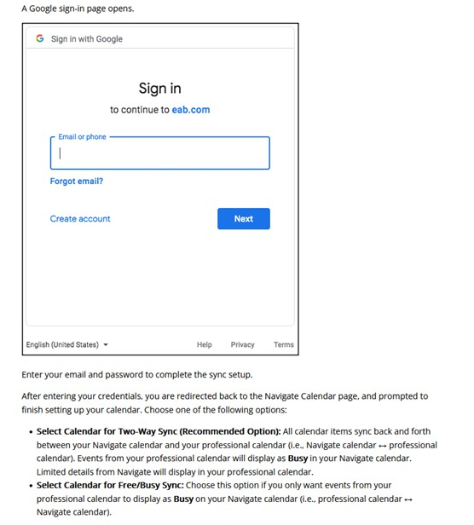

Slide 8
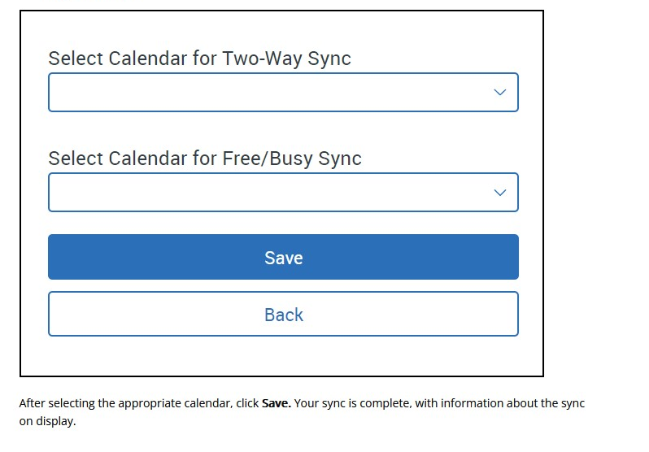
Select your Google calendar for both two-way sync and free/busy sync.

Slide 9
102 McMahon
success.catholic.edu
202-319-6262
success@cua.edu
Notes:
If you have further questions, please feel free to reach out to our office.

