Slide 1
EAB-Navigate
Notes:
Purpose: To show how useful Navigate can be for faculty and staff. Use of Navigate increases communication between offices because the advice given to students is documented in their educational record.

Slide 2
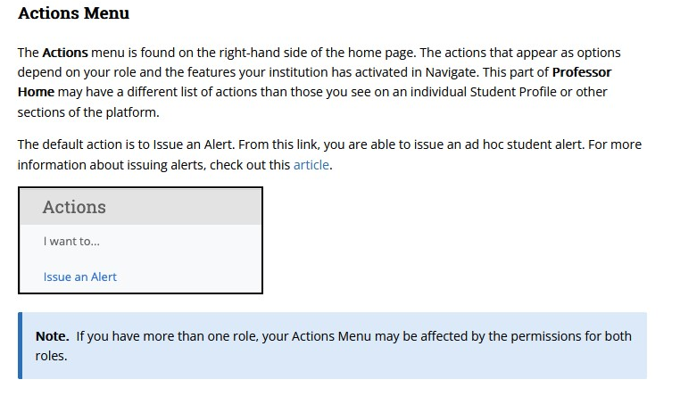

Slide 3
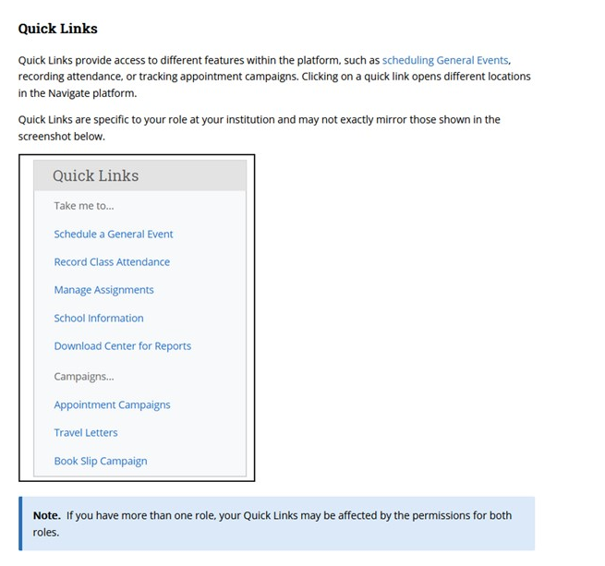

Slide 4
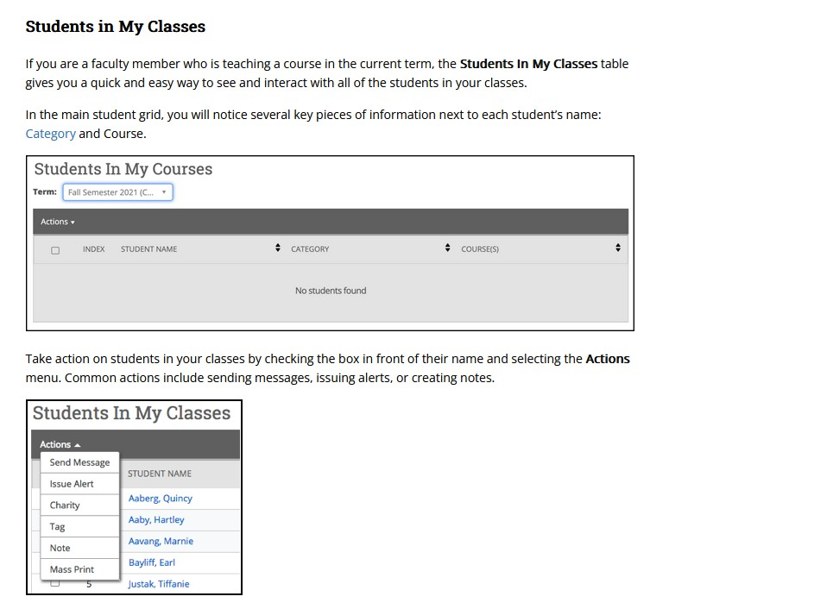

Slide 5
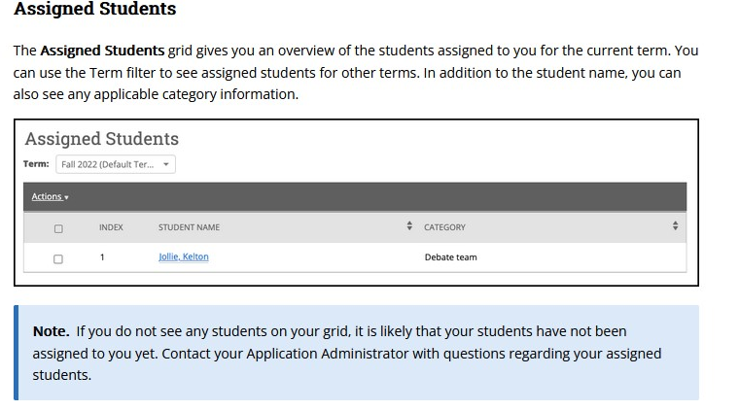

Slide 6
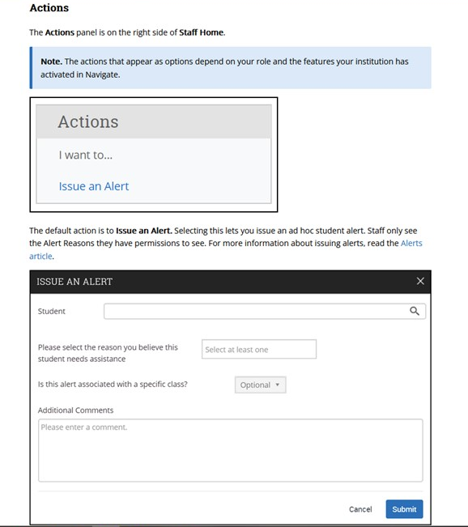

Slide 7
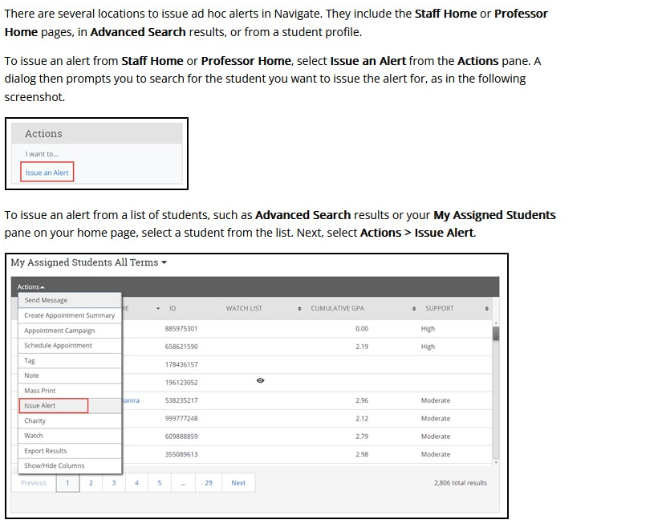
Issuing an Alert
You can issue an alert on a student at any time. Alerts are a way to draw attention to a student who might be at risk for a variety of reasons, such as losing financial aid, needing tutoring, or intending to withdraw from the institution. Issuing an alert can draw attention to these students, create a virtual referral, and prompt action from another department. Access to alerts is based on your user role permissions.

Slide 8
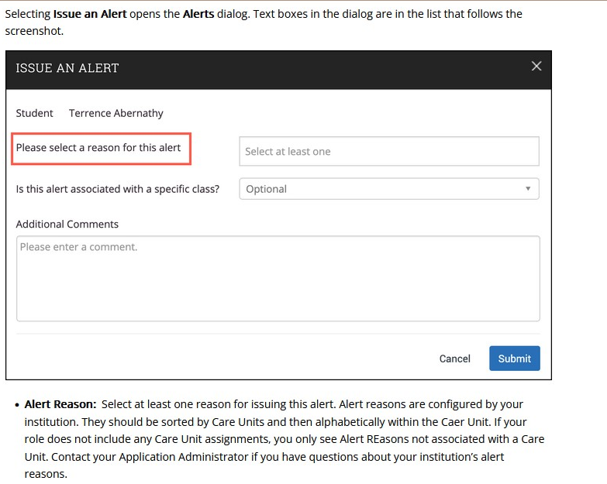
Association with Specific Course Select a course from the list if the alert is associated with a specific course the student is currently enrolled in.
Additional Comments: Enter comments in this box. Staff and faculty with permission can view the alert and its comments. There is no character limit to this field.

Slide 9
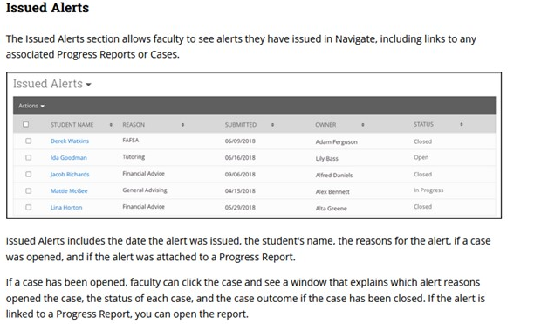

Slide 10
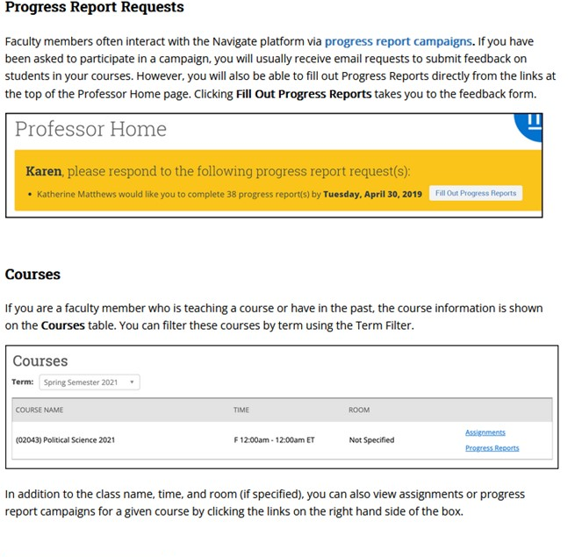

Slide 11
102 McMahon
success.catholic.edu
202-319-6262
success@cua.edu
Notes:
If you have further questions, please feel free to reach out to our office.

